Slide 1






Protex AI: Industrial Safety CV Pipeline
Kal Kahloot - Engineering Manager Assignment
25/11/2025

Slide 2

Agenda
Meet Kal
Problem & Objectives
Pipeline Overview
Stage 1 – Preprocessing
Stage 2 – Pre-tagging
Stage 3 – Cleanup
Examples
Features & Annotator Customization
Scaling & Production Considerations
Conclustion

Slide 3

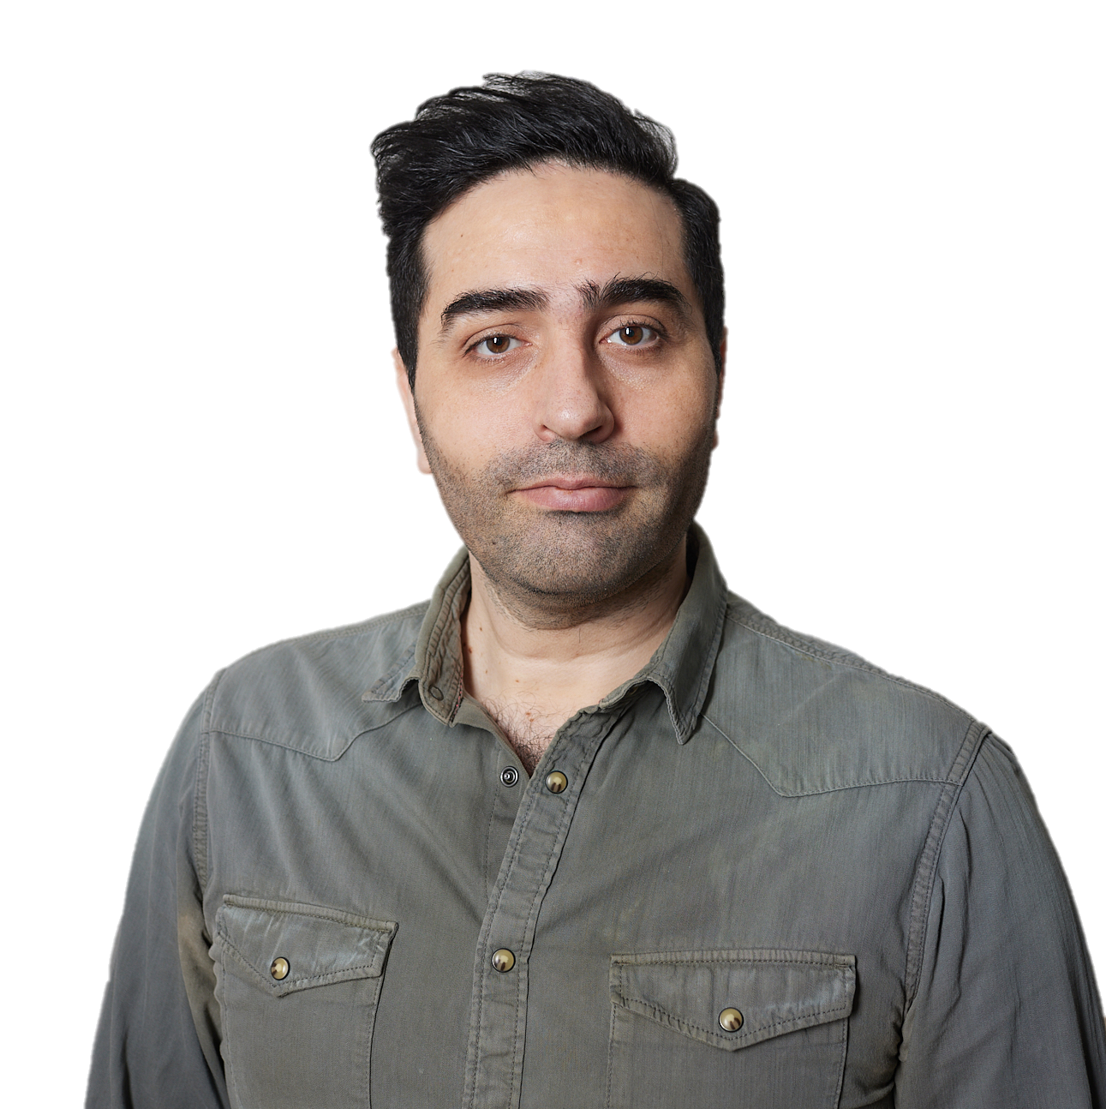
Meet the presenter
• Professional AI/Data Pipeline Plumber.
• Fluent in Python, caffeinated beverages, and stack overflow.
• Once argued with a GPU. The GPU won.
• Prefers his annotations medium rare — lightly pre-tagged, gently cleaned.
• Seasons his pipeline with research & science generously.
• Known to deliver locker-room motivation speeches for the team.
• Clears blockers like a snow sweeper tractor in a blizzard.

Slide 4

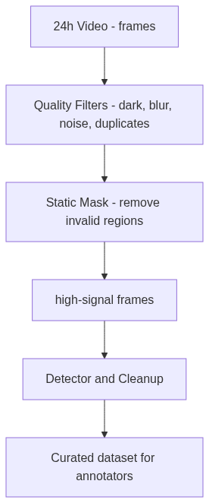
Problem & Objectives
Transform one 24-h camera feed into high-signal dataset
Focus on design choices, trade-offs

Slide 5
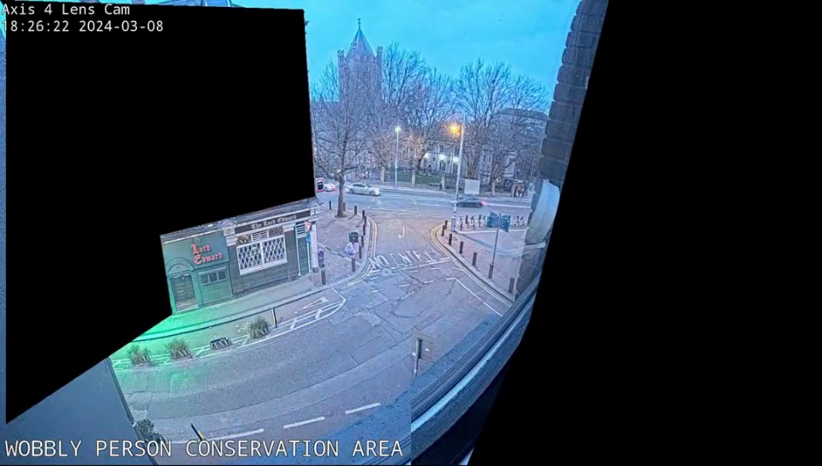
Let’s 👀@ scene

Slide 6
Problem
The Problem
24h CCTV feeds → huge volume, tiny useful signal
Most frames are routine; risky moments are rare
Manual reviewing is slow, expensive, and inconsistent
Raw video is unusable without structure or filtering
Need a way to surface traffic violations + unsafe behaviour fast
Notes:
Why It Matters
Safety teams want events, not hours of footage
Must cut noise before detection and annotation
Must reduce GPU cost + human labeling cost
Must ensure frames are high-quality (not dark/blurry/duplicates)

Slide 7
Success Criteria
Success Criteria
Massive frame reduction (e.g., 4,077 → 27)
Only valid, non-dark, non-blurry, non-noise frames survive
Detector sees clean regions (masking removes camera artifacts)
Pre-tags reduce annotator workload by 50–70%
Clear, reproducible, config-driven pipeline

Slide 8
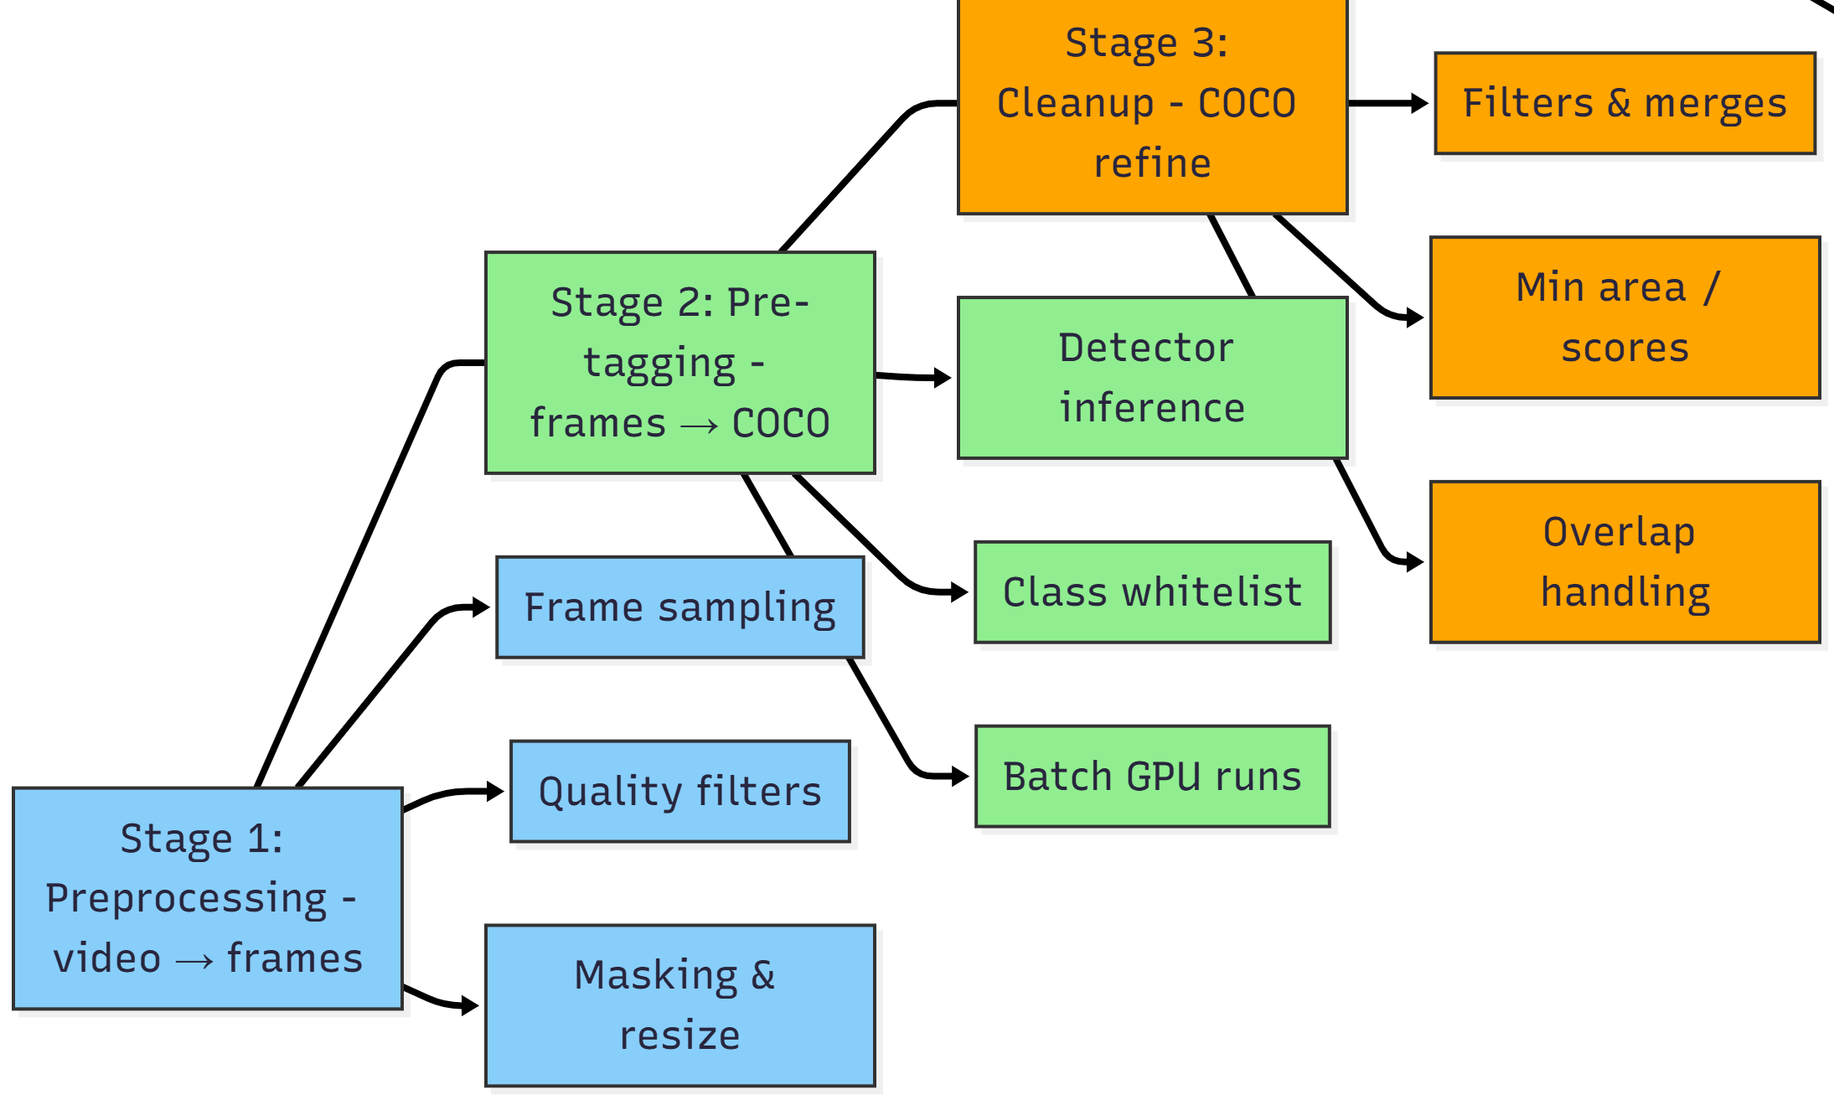
Pipeline Overview

Slide 9
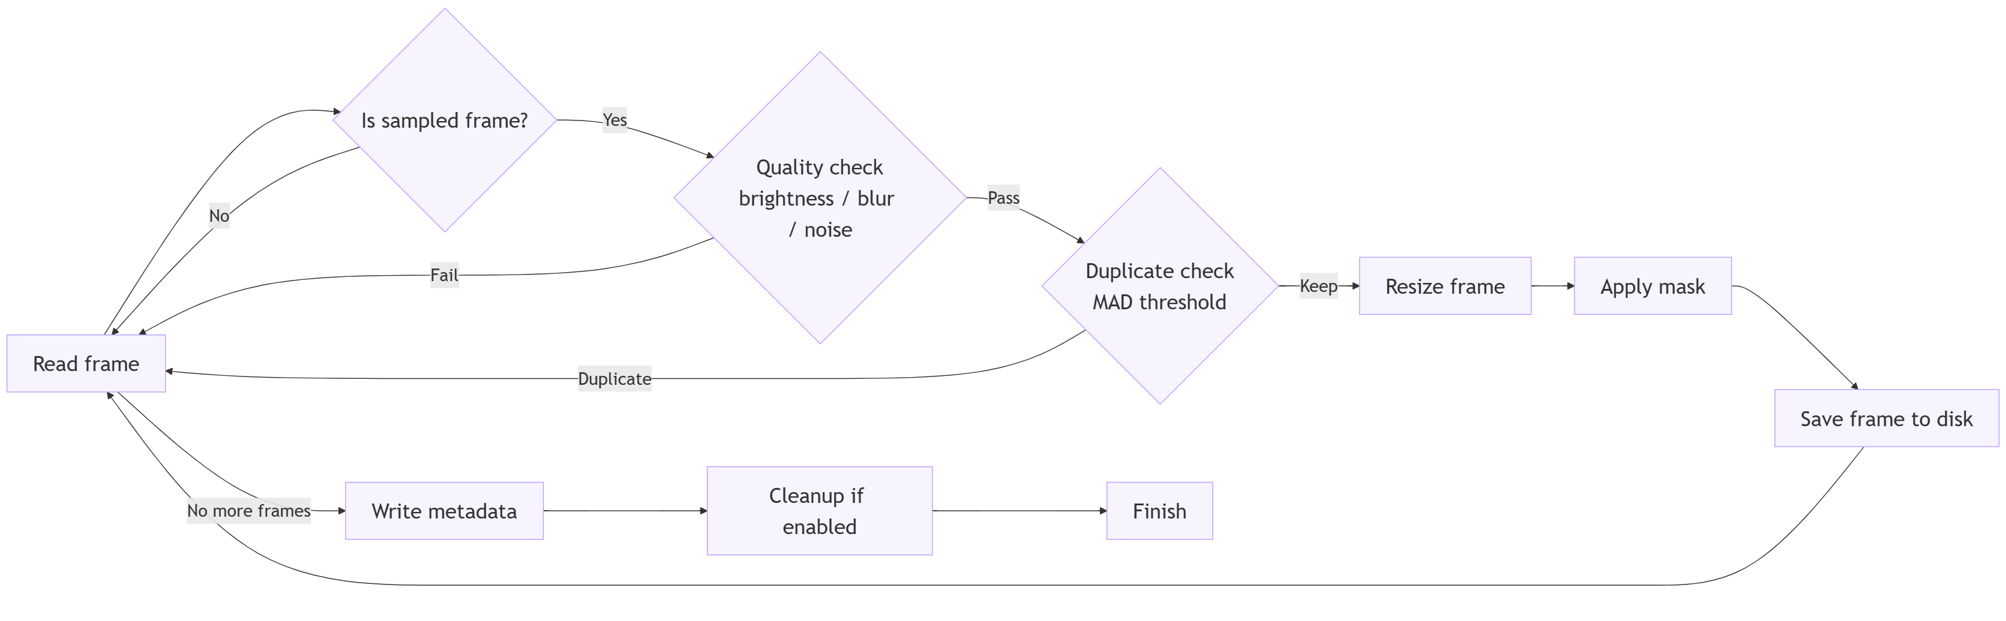
Stage 1:
Preprocessing: video → cleaned frames
01_data_preprocessing.py
frames_metadata.json

Slide 10
OpenCV Decoding + Sampling (0.8 FPS)
Alternatives
• Ffmpeg:
ultra-fast,
but limited per-frame logic
• GPU decoders:
NVIDIA VPF / NVDEC
for batch video decode
• Cloud media pipelines:
Gstreamer
MediaPipe
Why OpenCV
• Gives full control over frame-by-frame decisions.
• Easy to combine sampling + dedup + quality filters in one step
• FFmpeg too rigid for fine-grained preprocessing logic
• GPU decoders unnecessary for single-camera or PoC scale
4,077 raw frames
Video @ 32 FPS:
[0][1][2][3][4][5][6][7][8][9]...
Keep every 40th:
[0] [40] [80] [120]...
→ 128 candidate frames
Notes:
Why we need it
• 24h video produces thousands of redundant frames
• Most frames show no meaningful activity (empty street)
• Sampling reduces GPU cost and annotation time dramatically
• Keeps enough temporal coverage to catch real events

Slide 11
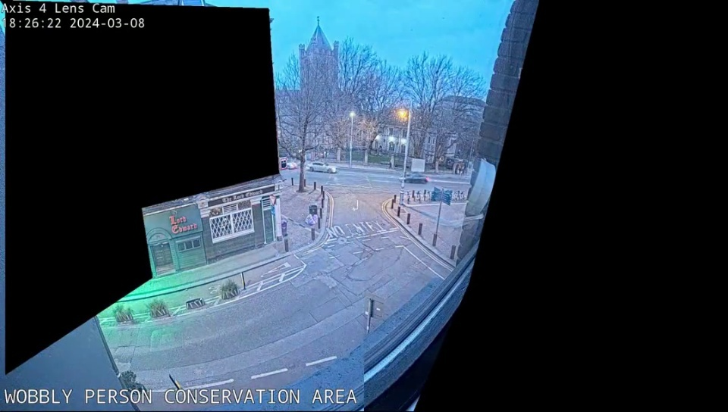

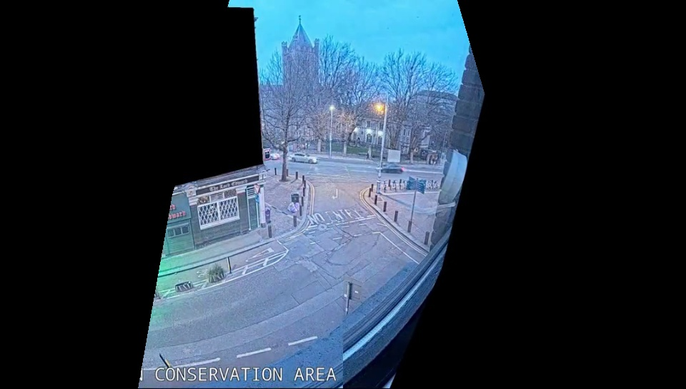
Masking & Resizing
Notes:
Why we need it
• Remove invalid camera regions (black polygons, occlusions)
• Prevent false detections in areas that should never contain objects
• Standardize resolution for stable detector performance
• Reduce noise → reduce annotation workload → save GPU cycles.
Technology Choice
• Chosen: OpenCV (cv2) for masking + resizing
• Uses grayscale mask (0 = drop, 255 = keep)
• Fast, simple, deterministic, and works per-frame
Alternatives
• FFmpeg filters (drawbox, blend, alpha masks)
• GPU-based preprocessing (NVIDIA VPF, torchvision transforms)
• ML-based segmentation masks (overkill for static cameras)
Why this choice
• OpenCV is lightweight, reliable, and easy to configure per site
• Masking is static — no need for expensive GPU-based methods
• FFmpeg is fast but not flexible for frame-by-frame logic
• Keeps pipeline reproducible and easy to modify with client-specific masks

Slide 12
Quality Filters (Dark / Blur / Noise / Duplicates)
Dark Frame Example
┌──────────────────┐
│ ░░░░░░░░░░░░░░░░░░░░░░░░ │ ← low brightness
│ ░░░░ barely any detail ░░ │
│ ░░░░░░░░░░░░░░░░░░░░░░░░ │
└─────────────────────┘
Brightness histogram
0───────────────50────────255
██████████░░░░░░░░░░░░░░░░░░
^ too dark → drop
Noisy Frame Example
┌─────────────────┐
│ ▒▒▒▒▒▒▒▒▒▒▒▒▒▒▒▒▒▒▒▒▒▒▒ │
│ ☠ random pixels everywhere │ ← high noise level
│ ▒▒▒▒▒▒▒▒▒▒▒▒▒▒▒▒▒▒▒▒▒▒▒ │
└─────────────────┘
Noise score
clean──────────────────────────noisy
███████████████████████████▓▓▓▓▓▓▓▓
^ drop
Blurry Frame Example
┌────────────┐
│ 〰〰〰〰〰 shapes soft │
│ person? car? who knows │ ← low Laplacian variance
│ 〰〰〰〰〰〰〰〰〰〰 │
└────────────┘
Sharpness measure (Laplacian Var.)
0─────low──────medium─────────high
█████░░░░░░░░░░░░░░░░
^ too blurry → drop
Consecutive frames:
Frame t Frame t+1 Frame t+2
┌───┐ ┌───┐ ┌───┐
│ 🚗 │ │ 🚗 │ │ 🚚 │
└───┘ └───┘ └───┘
SSIM(t, t+1) = 0.998 → duplicate → DROP
SSIM(t+1, t+2) = 0.72 → new scene → KEEP
Notes:
Why we need them
• Remove frames that detectors fail on (night, glare, blur)
• Reduce GPU waste on junk / unreadable frames
• Prevent annotators from seeing useless or impossible images
• Improve downstream model signal → noise ratio
Quality filters require the raw frame
Brightness, blur, and SSIM behave best on original resolution because:
Resizing changes pixel distributions (brightness histograms shift)
Blur detection (Laplacian variance) becomes artificially low after resize
Noise detection becomes harder because compression removes high-frequency noise
SSIM becomes biased because resampling smooths details
In short:
If you downsize first, the quality metrics become unreliable, and you will misclassify frames.

Slide 13
Stage 1: Results: 99.3% Reduction Duration: 9 seconds
Notes:
This dataset:
• Input: 4,077 video frames (32 FPS)
• Sampled: Every 40 frames (0.8 FPS)
• Standardize to 960×544, JPEG
• Output: 27 filtered frames
• Reduction: 99.3%
Filters removed:
• 71 duplicates, 4 noise frames

Slide 14

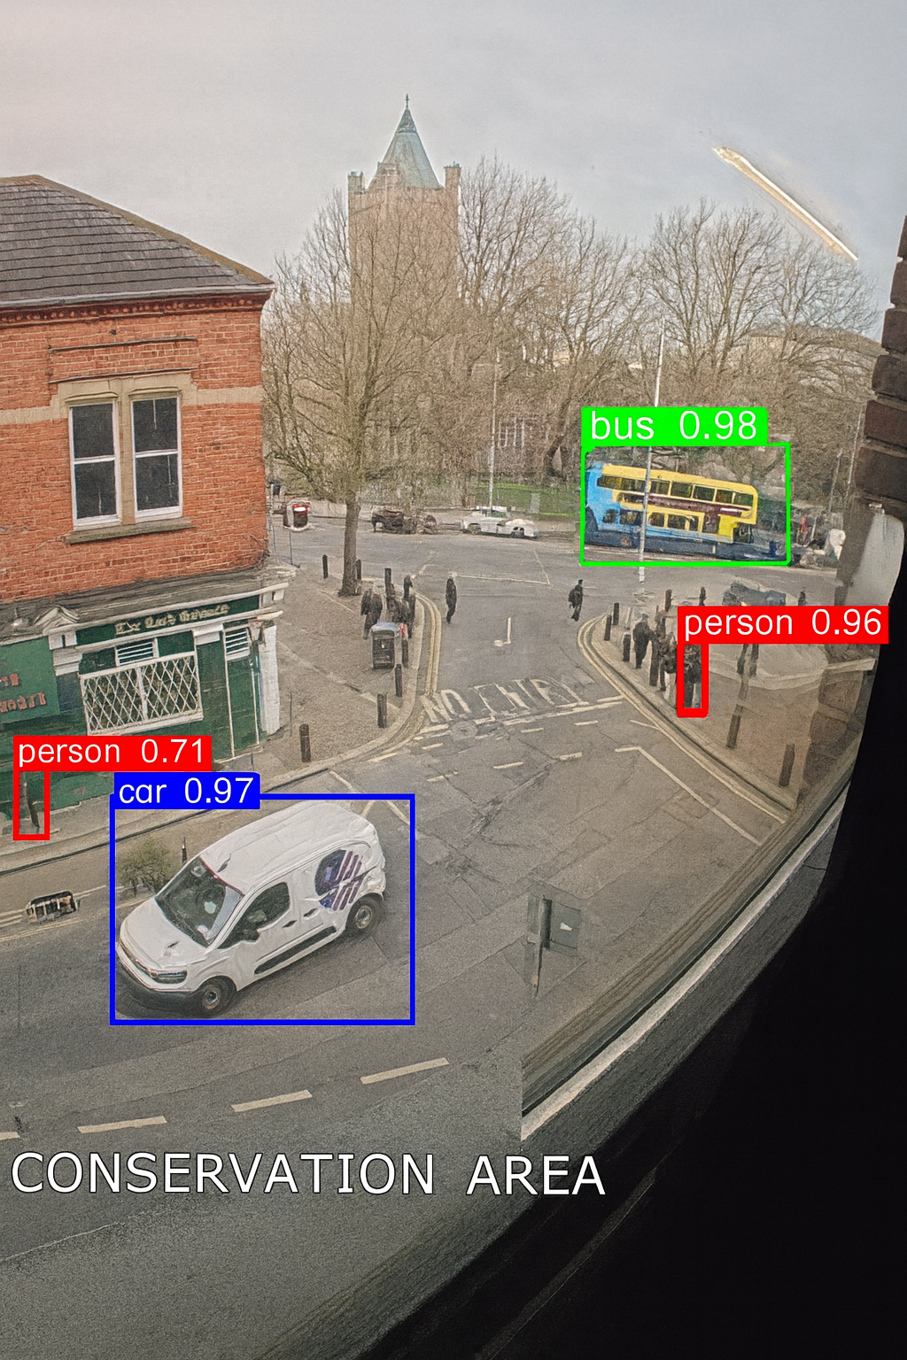
Stage 2: Pre-tagging
Detector:
Faster R-CNN ResNet50 FPN (PyTorch / torchvision)
Reasons:
Strong baseline, COCO-trained, easy to plug into PyTorch stack
Safety-relevant class whitelist:
9 street classes (person + vehicles + infra)
Alternatives:
YOLOv8/10, DETR / DINO, TensorRT-optimized edge models

Slide 15
Stage 2: Strong Front Runner
Model | Key Strength | mAP@0.5 (COCO subset) | Primary Advantage
R-CNN ResNet50 FPN | Balances accuracy with reasonable inference speed | 61.1% | Region Proposal Network (RPN)
YOLOv10n | Speed/Efficiency (NMS-free) | 50.74% | Very fast inference for resource-constrained environments.
YOLO11n | Overall Performance (SOTA) | 51.45% | The most recent stable model with robust performance across general tasks.
YOLOv9t | Accuracy (Information retention) | 48.60% | Effective at retaining gradient information, good for specific high-precision tasks.
Notes:
Model Comparisons: Choose the Best Object Detection Model for Your Project
Faster R-CNN Resnet 50 FPN. In the evolving world of computer… | by Sayan Daskhan | Medium

Slide 16
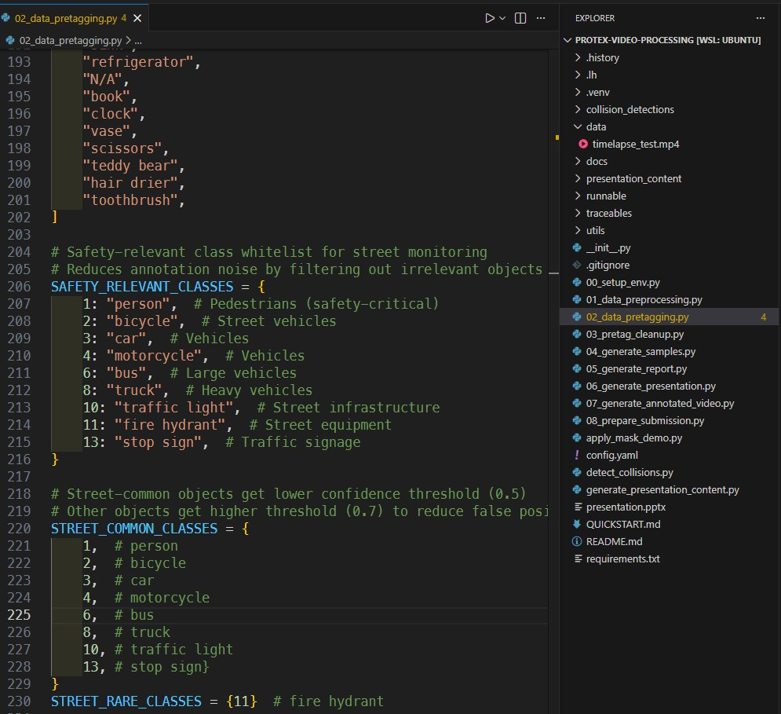
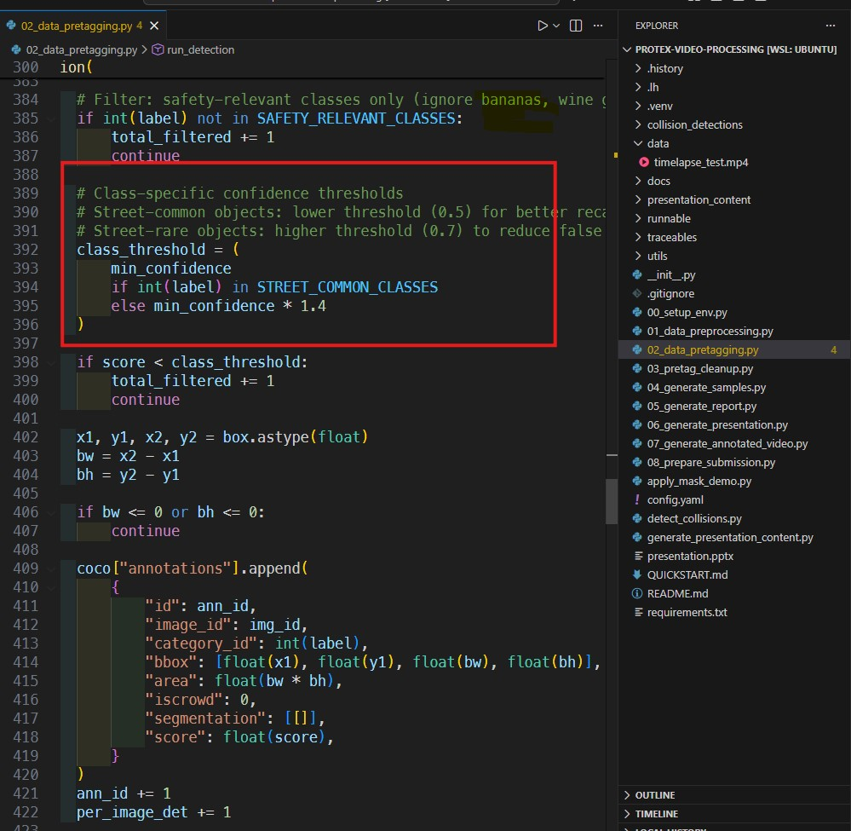
Stage 2: filter to 9 safety-relevant classes—person, car, truck, bus, bike, and key street infrastructure

Slide 17
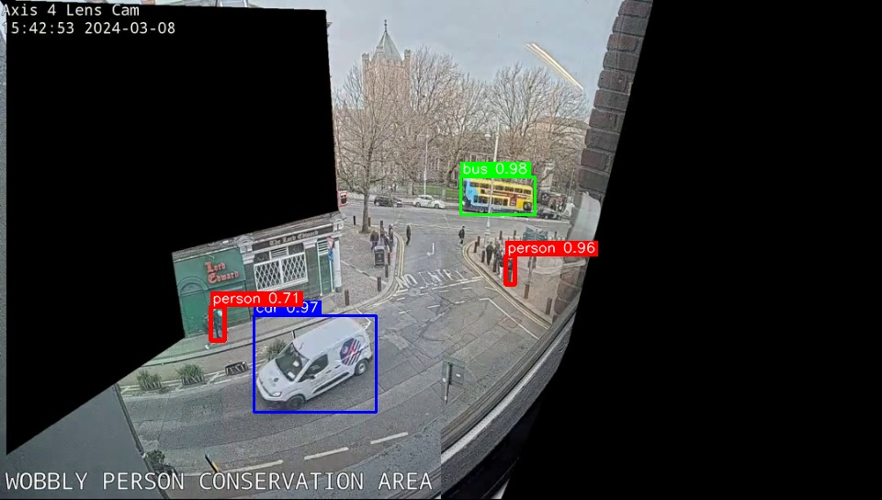
Complex Scenes: pre‑tagging accelerates annotation but still requires human oversight to correct missing or erroneous labels

Slide 18
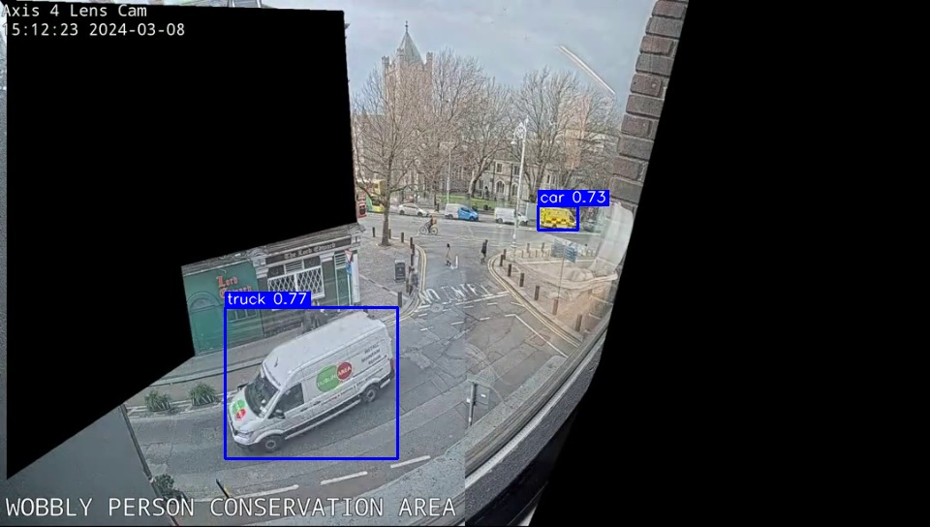
Complex Scenes: pre‑tagging accelerates annotation but still requires human oversight to correct missing or erroneous labels

Slide 19
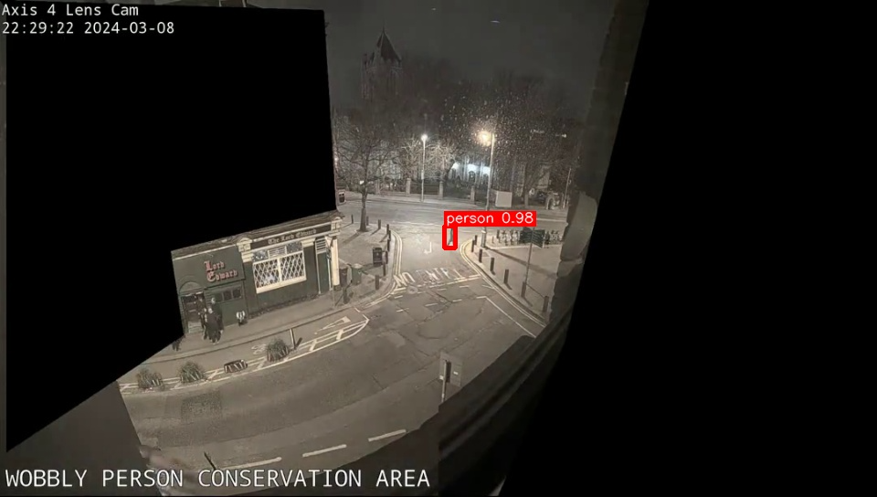
Detection Quality: Person detection in varying lighting conditions

Slide 20
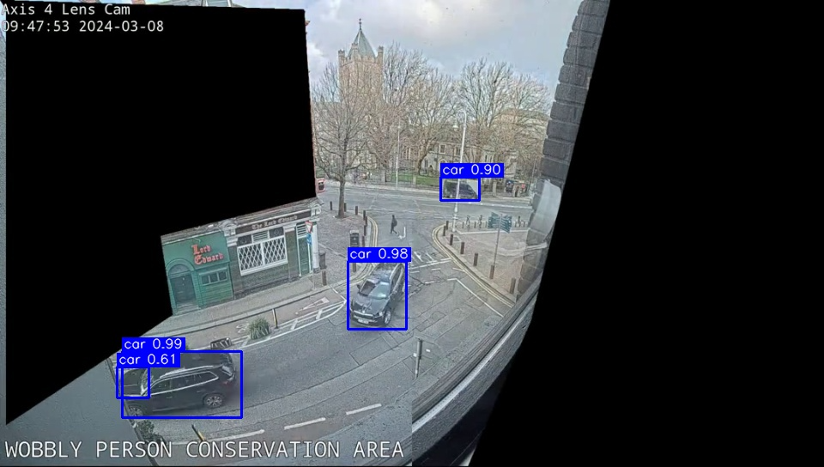
Multiple Objects: Multiple cars detected in complex scene

Slide 21
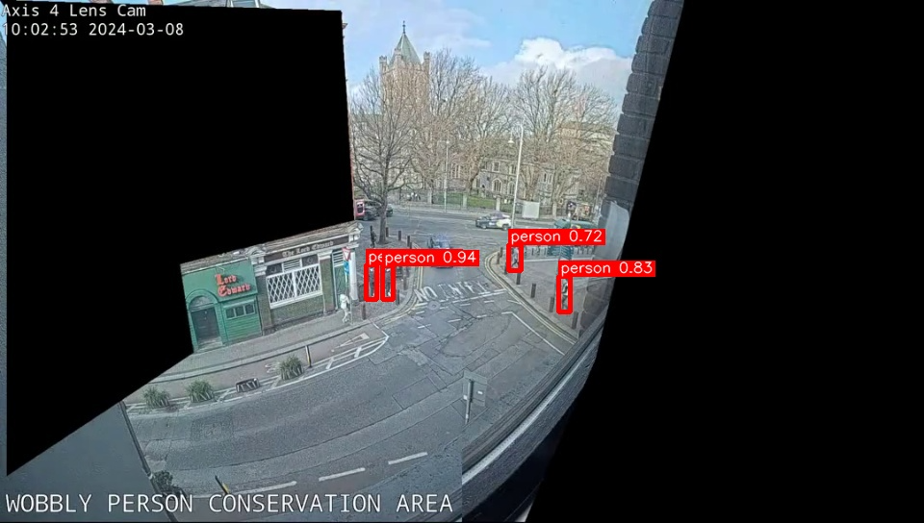
Multiple Objects: Multiple persons detected in complex scene

Slide 22




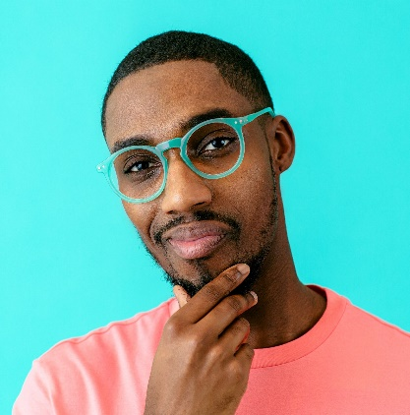
Stage 3: Cleanup - raw pre-tags → filtered COCO
Module: 03_pretag_cleanup.py - COCO Config file: pre_tags/pre_tags_raw.json

Slide 23
Stage 3: Cleanup Heuristics & Options
Cleanup is intentionally simple but class-aware:
People are safety-critical, so even small distant pedestrians survive; tiny ‘truck’ blobs do not.”
We keep confidence in the cleaned COCO:
Annotator tooling can render low-confidence boxes in orange to prioritise review.
Alternatives:
Soft-NMS,
learned quality scores,
Per-camera adaptive thresholds based on annotator feedback
Class-aware min area + score thresholds
People: smaller area threshold (≥300 px²); vehicles: ≥1000 px²
Drop invalid / overlapping boxes, keep confidence as confidence field
Modes: fast vs balanced vs accurate → different annotation volumes & cost
Notes:
Soft Non-Maximum Suppression that decays confidence scores instead of discarding overlapping boxes

Slide 24
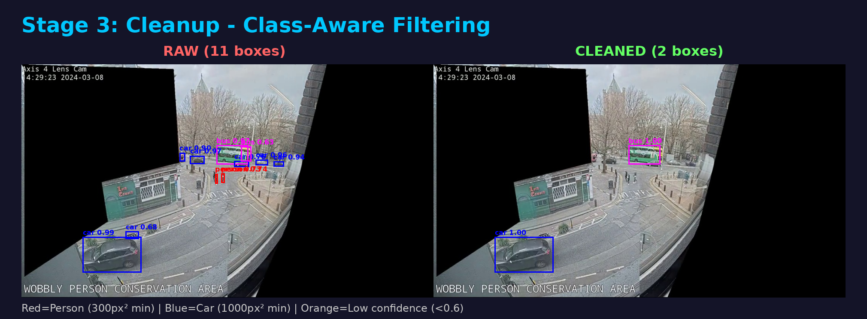

Slide 25
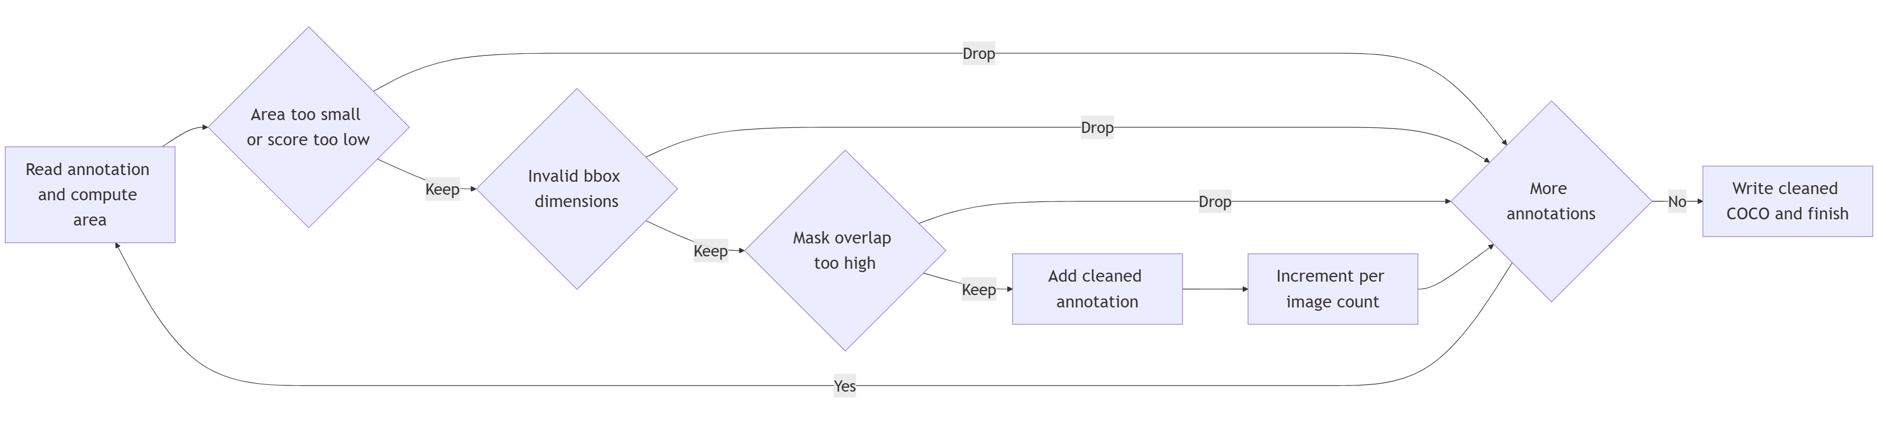
Stage 3: Cleanup Heuristics & Options

Slide 26

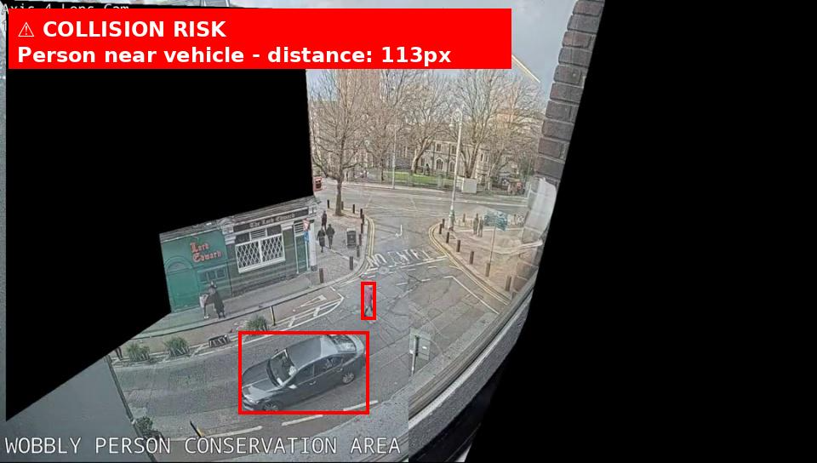

Hazard

Slide 27


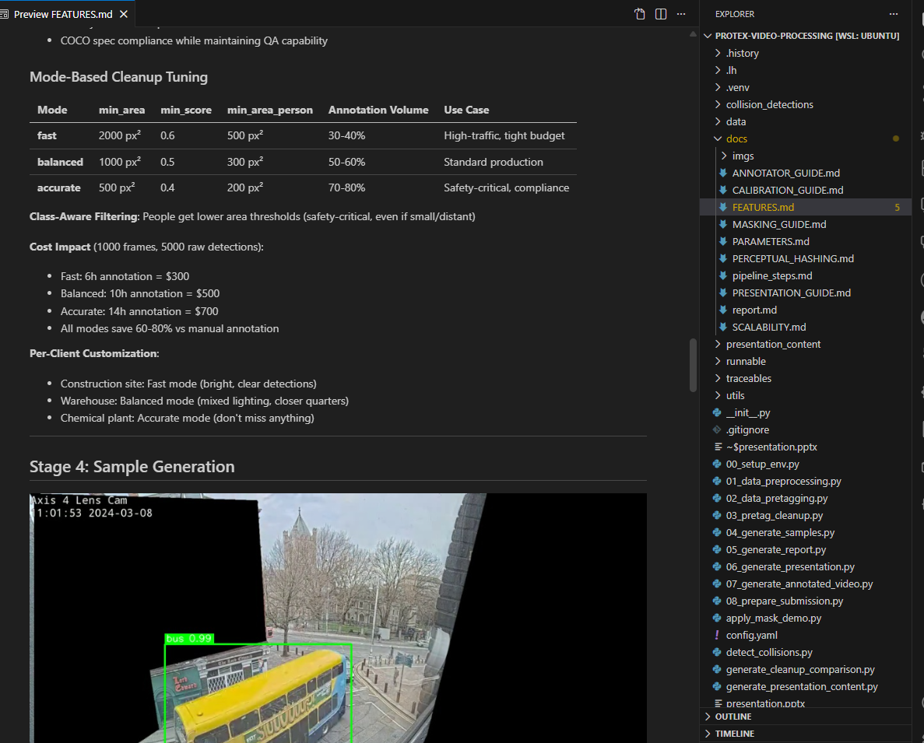

Closer Look

Slide 28
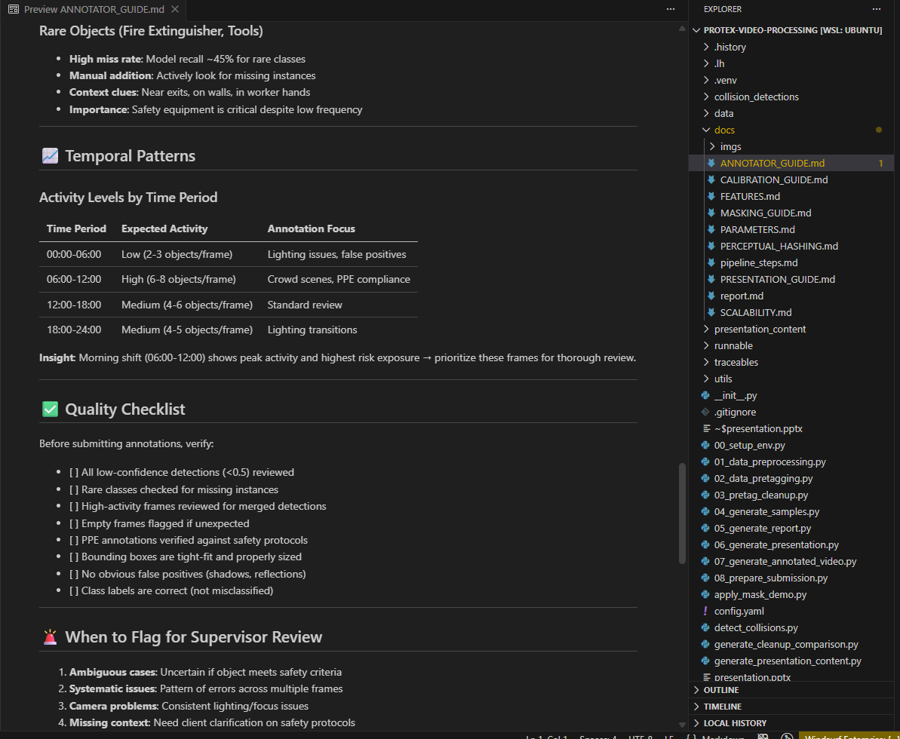
Closer Look

Slide 29
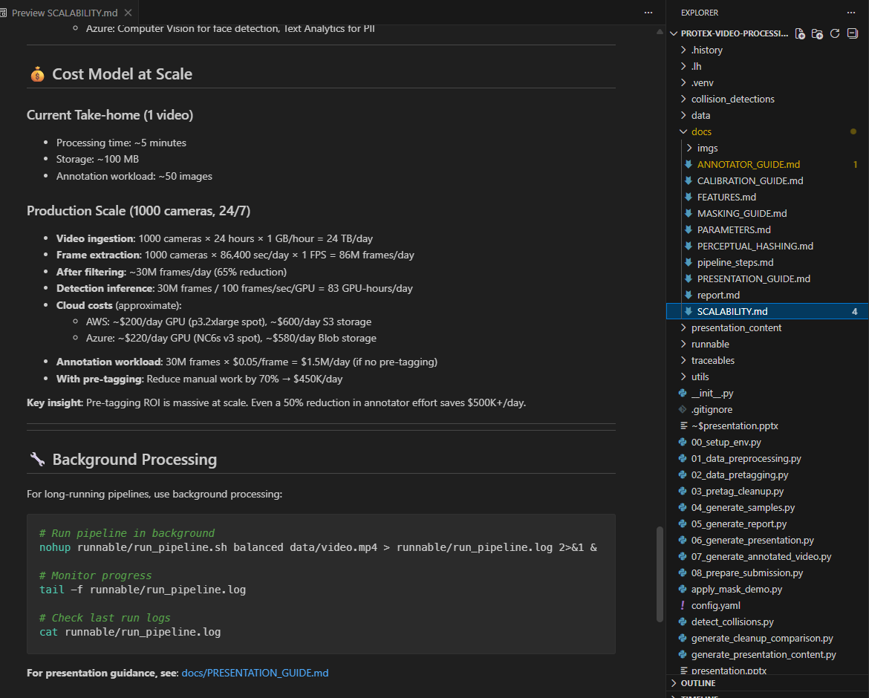
Closer Look

Slide 30
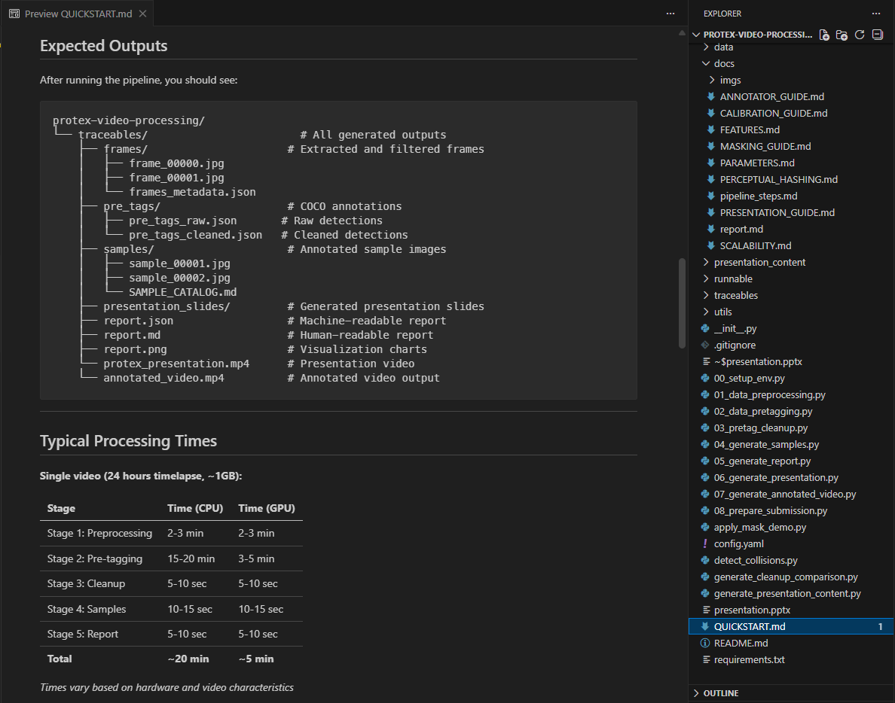
Closer Look

Slide 31
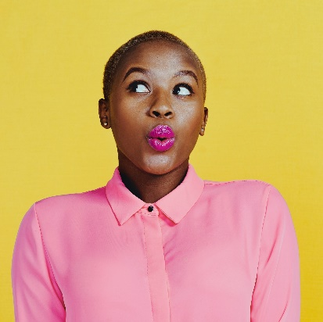
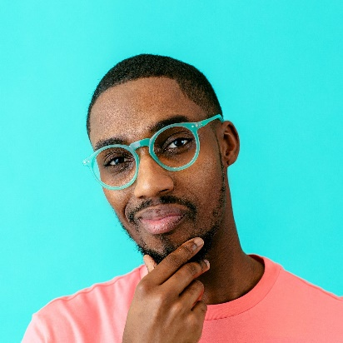

Thank you

